Slide 1
Tracing is for everyone:
Tracing user events with GraphQL and OpenTelemetry
Nina Stawski, Splunk

Slide 2
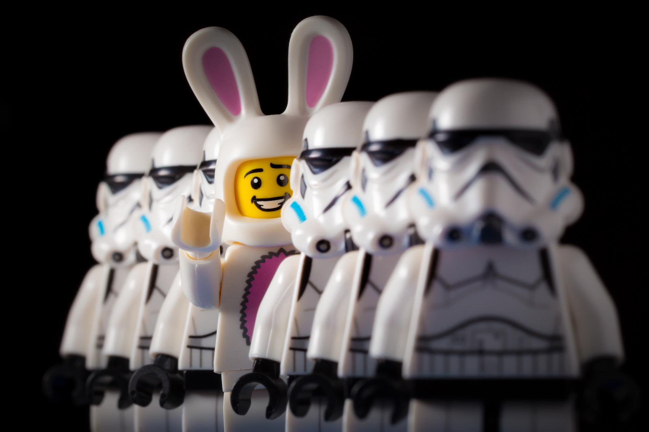
Front-End? Really?
© https://www.flickr.com/photos/clement127/19093561751

Slide 3
Front-End? Really?
UI is always blamed first

Slide 4
Front-End? Really?
UI is always blamed first
Performance issues are hard to track

Slide 5
Front-End? Really?
UI is always blamed first
Performance issues are hard to track
Front-end analytics is not enough in complex cases

Slide 6
Front-End? Really?
UI is always blamed first
Performance issues are hard to track
Front-end analytics is not enough in complex cases
Back-end and OPS have nice tools at their disposal

Slide 7
Front-End? Really?
UI is always blamed first
Performance issues are hard to track
Front-end analytics is not enough in complex cases
Back-end and OPS have nice tools at their disposal
And what about front-end microservices?

Slide 8
Front-End. Really!
UI is always blamed first
Performance issues are hard to track
Front-end analytics is not enough in complex cases
Back-end and OPS have nice tools at their disposal
And what about front-end microservices? (yes, we are engineers too! ;)

Slide 9

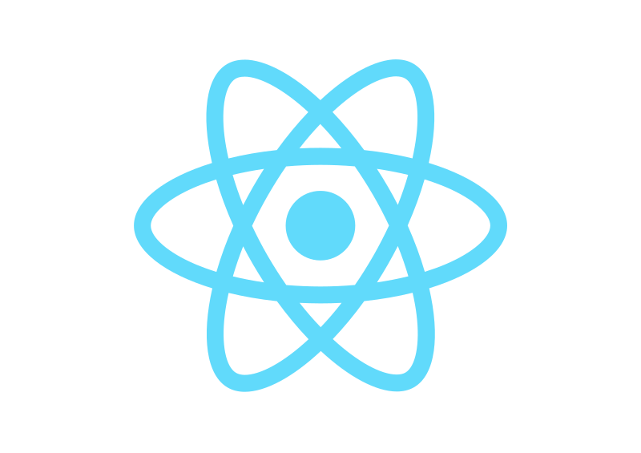
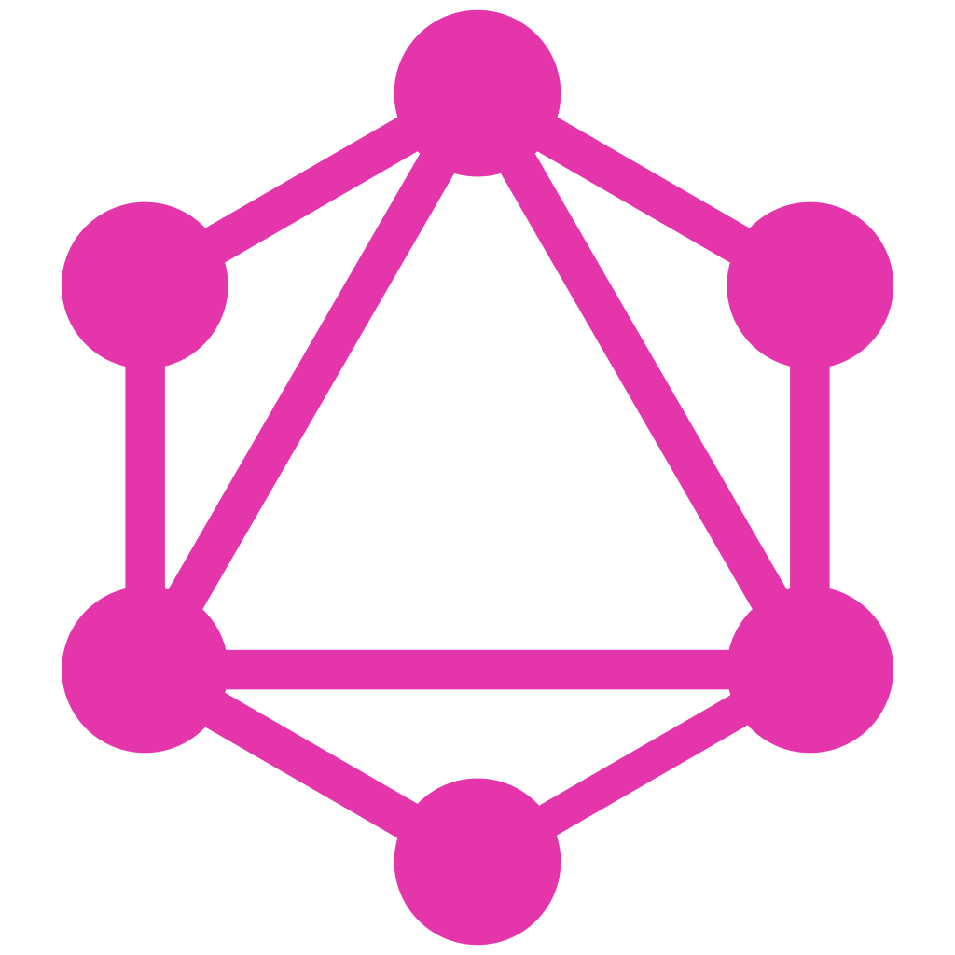

Front-End is more than the UI

Slide 10

Front-End is more than the UI
+

Slide 11
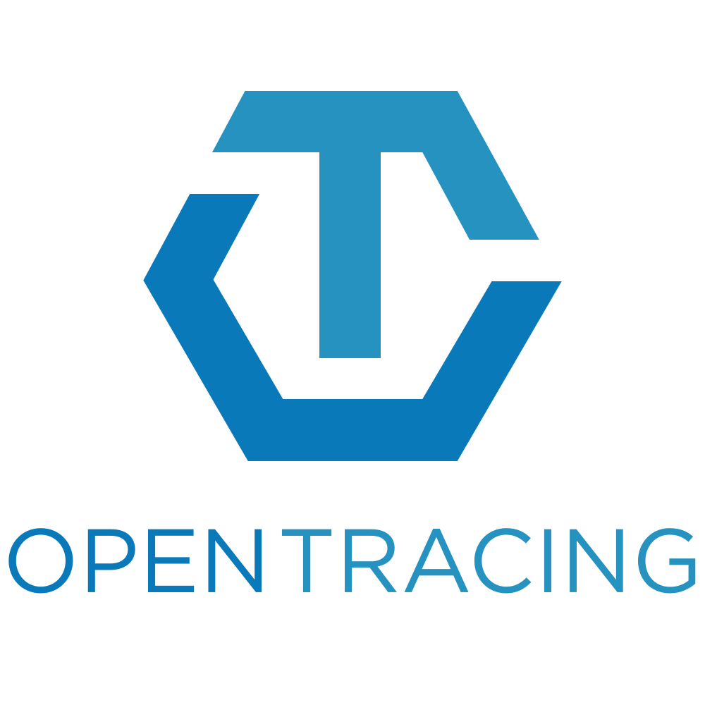



What is OpenTelemetry?
=
+

Slide 12
What is OpenTelemetry?
=
+
https://github.com/open-telemetry/opentelemetry-js

Slide 13
What is Observability?
Traces
Metrics

Slide 14
What is Observability?
Traces
Series of related events that represent an end-to-end event flow through a distributed system
Metrics

Slide 15
What is Observability?
Traces
Series of related events that represent an end-to-end event flow through a distributed system
For Backend: usually a request flow through multiple microservices
Metrics

Slide 16
What is Observability?
Traces
Series of related events that represent an end-to-end event flow through a distributed system
For Backend: usually a request flow through multiple microservices
get user info
UI
Middleware
User service
Database
Metrics

Slide 17
What is Observability?
Traces
Series of related events that represent an end-to-end event flow through a distributed system
For Backend: usually a request flow through multiple microservices
get user info
get user info
UI
UI
Database
User service
Database
Middleware
User service
Middleware
Metrics
A numeric representation of data measured over intervals of time

Slide 18
What is Observability?
Traces
Series of related events that represent an end-to-end event flow through a distributed system
For Backend: usually a request flow through multiple microservices
get user info
get user info
UI
UI
Database
User service
Database
Middleware
User service
Middleware
Metrics
A numeric representation of data measured over intervals of time
For example, number of requests per minute

Slide 19
What is Observability?
UI

Slide 20
What is Observability?
UI
But UI is much more than just a service!

Slide 21
Observability in UI?
UI
But UI is much more than just a service!

Slide 22
Observability in UI?
UI
But UI is much more than just a service!
Users do a lot on the page in modern apps

Slide 23
Observability in UI?
UI
But UI is much more than just a service!
Users do a lot on the page in modern apps
It might trigger multiple backend calls

Slide 24
Observability in UI?
UI
But UI is much more than just a service!
Users do a lot on the page in modern apps
It might trigger multiple backend calls
Performance issues are hard to track

Slide 25
Observability in UI?
UI
But UI is much more than just a service!
Users do a lot on the page in modern apps
It might trigger multiple backend calls
Performance issues are hard to track
If something fails, how do we know where the problem is?

Slide 26
Observability in UI
Users do a lot on the page in modern apps
It might trigger multiple backend calls
Performance issues are hard to track
If something fails, how do we know where the problem is?

Slide 27
Observability in UI!
Users do a lot on the page in modern apps
It might trigger multiple backend calls
Performance issues are hard to track
If something fails, how do we know where the problem is?

Slide 28
Observability in UI
+

Slide 29
Observability in UI
+
Tab 1
Tab 2
React UI

Slide 30
Observability in UI
+
Tab 1
Tab 2
React UI
Capture user actions

Slide 31
Observability in UI
+
Tab 1
Tab 2
GraphQL Backend
React UI
Capture user actions

Slide 32
Observability in UI
+
Tab 1
Tab 2
GraphQL Backend
React UI
Capture user actions
Connect spans

Slide 33
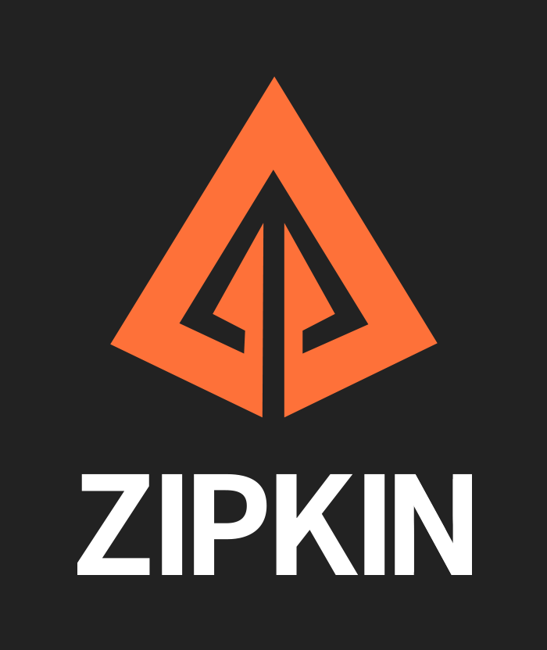
Observability in UI!
+
Tab 1
Tab 2
GraphQL Backend
React UI
Capture user actions
Connect spans

Slide 34
Observability in UI
+
Tab 1
Tab 2
GraphQL Backend
React UI
Capture user actions
Connect spans
Collect traces

Slide 35
Observability in UI
+
Tab 1
Tab 2
GraphQL Backend
React UI
Capture user actions
Connect spans
Collect traces
Full repo: https://github.com/nstawski/opentelemetry-graphql

Slide 36
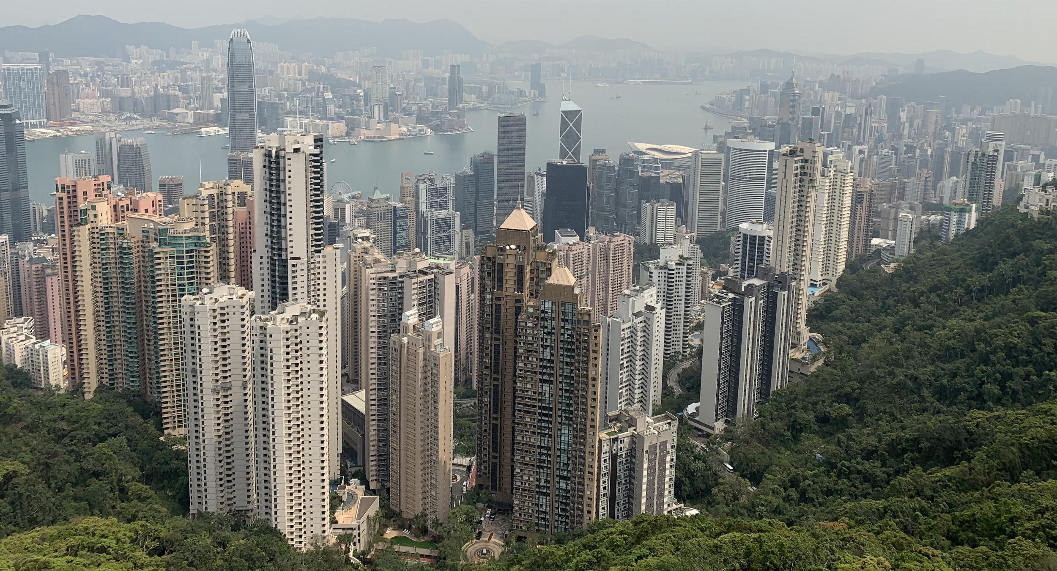
Demo time

Slide 37
What can we do?
Track user actions

Slide 38
What can we do?
Track user actions
Track user actions and backend requests as a part of the same trace

Slide 39
What can we do?
Track user actions
Track user actions and backend requests as a part of the same trace
Track durations for all actions to assess performance

Slide 40
What can we do?
Track user actions
Track user actions and backend requests as a part of the same trace
Track durations for all actions to assess performance (especially with multiple front-ends)

Slide 41
What can we do?
Track user actions
Track user actions and backend requests as a part of the same trace
Track durations for all actions to assess performance (especially with multiple front-ends)
If anything caused an error, quickly find where it happened

Slide 42
UI Observability

Slide 43
UI Observability
+

Slide 44
Thank you!
https://git.io/JJ4xN (https://github.com/nstawski/opentelemetry-graphql)

Slide 45


Thank you!
https://git.io/JJ4xN (https://github.com/nstawski/opentelemetry-graphql)
Nina Stawski, Splunk
ninastawski
nstawski

